Slide 1

2D SLAM Project: Occupancy Grid Mapping with Scan Matching, FastSLAM and Particle Filters Autonomous Mapping and Localization with 2D LiDAR Data
Faculty of Computer Science
Geo Spacial Data Science
Moscow 2024
The presentation was prepared by Muhammad Zeeshan Asghar

Slide 2
Outline
Data science
2D SLAM Project: Occupancy Grid Mapping with Scan Matching, FastSLAM and Particle Filters
Outline
Problem Statement
Input Data Description
Output Data Description
Methodology Overview
Occupancy Grid Mapping
6. Scan Matching
7. FastSLAM Algorithm
8. Demo
9. References

Slide 3
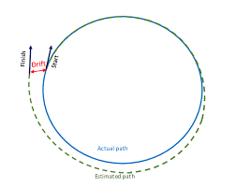
Problem Statement
Data science
2D SLAM Project: Occupancy Grid Mapping with Scan Matching, FastSLAM and Particle Filters
Problem Statement
Core Challenge: Enable robots to build a map of an environment while accurately localizing themselves, known as Simultaneous Localization and Mapping (SLAM).
Objective: Develop a 2D SLAM solution using FastSLAM with particle filters to generate accurate, real-time maps from noisy sensor data.
Key Challenges:
Handling sensor noise and odometry drift.
Efficient map update and accurate pose estimation.
Achieving loop closure for consistent map updates.

Slide 4
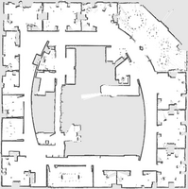
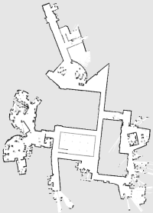
Input Data Description
Data science
2D SLAM Project: Occupancy Grid Mapping with Scan Matching, FastSLAM and Particle Filters
Input Data Description
Data Sources:
Intel Research Lab SLAM dataset by Dirk Hähnel.
2D LiDAR Scans: 910 readings, 180° Field of View.
Odometry: x, y, and θ readings to track robot movement.
Ground Truth Data: Provides reference for map accuracy.
MIT Computer Science & Artificial Intelligence Laboratory SLAM dataset provided by Cyrill Stachniss
2D LiDAR Scans: 406 readings, 180° Field of View.
Odometry: x, y, and θ readings to track robot movement.
Ground Truth Data: Provides reference for map accuracy.

Slide 5
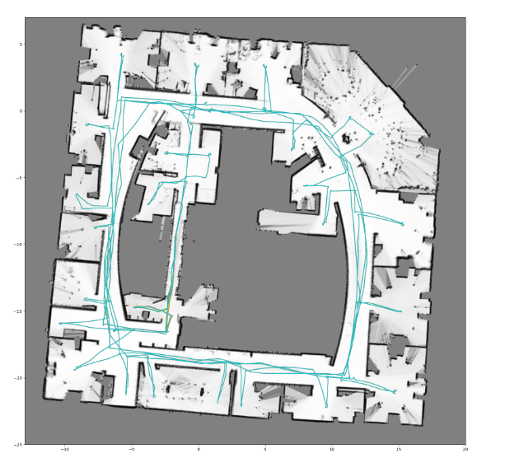
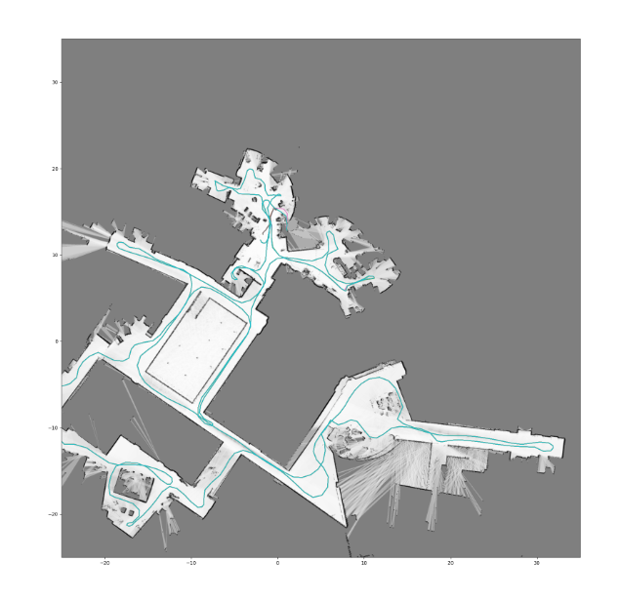
Output Data Description
Data Science
2D SLAM Project: Occupancy Grid Mapping with Scan Matching, FastSLAM and Particle Filters
Output Data Description
Final Outputs:
Occupancy Grid Map: Probabilistic map of the environment.
Robot Trajectory: Estimated path followed by the robot.
Other Outputs:
GIF animation showing map updates over time.
TIFF file of the final map with georeferencing to real-world coordinates.
Sample Visuals: Include snapshots of the final map and trajectory.

Slide 6
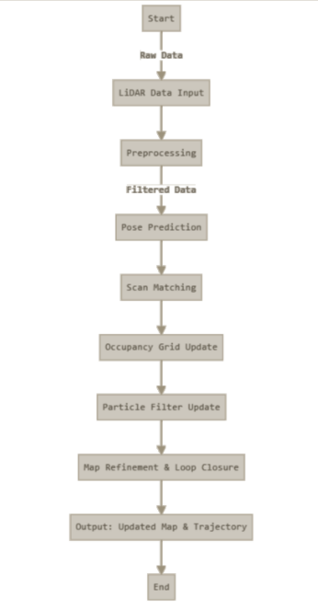
Methodology Overview
Data science
2D SLAM Project: Occupancy Grid Mapping with Scan Matching, FastSLAM and Particle Filters
Methodology Overview
Process Flow: High-level view of the main algorithm stages:
Occupancy Grid Mapping:
Updates cells based on LiDAR.
Scan Matching:
Aligns LiDAR data to refine pose.
FastSLAM with Particle Filters:
Probabilistic pose estimation.

Slide 7
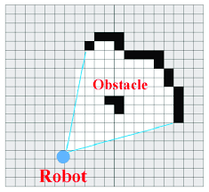
Occupancy Grid Mapping
Data science
2D SLAM Project: Occupancy Grid Mapping with Scan Matching, FastSLAM and Particle Filters
Occupancy Grid Mapping
Grid Concept:
Environment is divided into a grid; each cell holds an occupancy probability.
Update Mechanism:
Cells are updated based on LiDAR scan data.
Benefit:
Enables a dynamic, probabilistic map as the robot moves.
Visual Aid:
Diagram or example image of a 2D occupancy grid map.

Slide 8
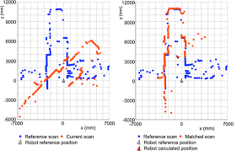
Scan Matching
Data science
2D SLAM Project: Occupancy Grid Mapping with Scan Matching, FastSLAM and Particle Filters
Scan Matching
Purpose: Refines pose estimates by matching LiDAR scans to the existing map.
Methodology: Uses a multi-resolution strategy for efficient matching.
Benefit: Reduces errors and enhances pose accuracy.

Slide 9
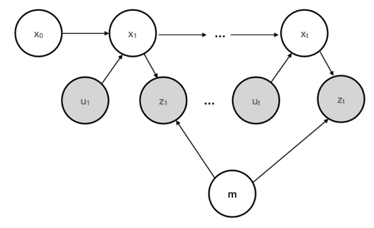
FastSLAM Algorithm
Data science
2D SLAM Project: Occupancy Grid Mapping with Scan Matching, FastSLAM and Particle Filters
FastSLAM Algorithm
Core Concept: Uses particles to represent possible robot poses.
Key Elements:
Particle Filters: Particles are weighted based on their match to sensor data.
Importance Sampling: Retains the most likely particles to refine pose.
Loop Closure: Corrects map when robot revisits areas.

Slide 10
Demo of Application in Action
Data science
2D SLAM Project: Occupancy Grid Mapping with Scan Matching, FastSLAM and Particle Filters
Demo of Application in Action
Demo Details:
Real-Time Mapping: Show map building as LiDAR data updates.
Trajectory Tracking: Illustrate robot’s estimated path.
Loop Closure: Show correction as the robot revisits mapped areas.

Slide 11
References
Data science
2D SLAM Project: Occupancy Grid Mapping with Scan Matching, FastSLAM and Particle Filters
References
Intel Research Lab SLAM dataset provided by Dirk Hähnel
MIT Computer Science & Artificial Intelligence Laboratory SLAM dataset provided by Cyrill Stachniss
Coursera - Motion Planning for Self-Driving Car - Occupancy Grids - https://www.coursera.org/lecture/motion-planning-self-driving-cars/lesson-1-occupancy-grids-oJcwU
FastSLAM: A Factored Solution to the Simultaneous Localization and Mapping Problem by M. Montemerlo, S. Thrun, D. Koller, and B. Wegbreit
A Frame-to-Frame Scan Matching Algorithm for 2D Lidar Based on Attention by Shan Huang 1,2 and Hong-Zhong Huang
Real-Time Loop Closure in 2D LIDAR SLAM by Wolfgang Hess, Damon Kohler, Holger Rapp and Daniel Andor

